Slide 1
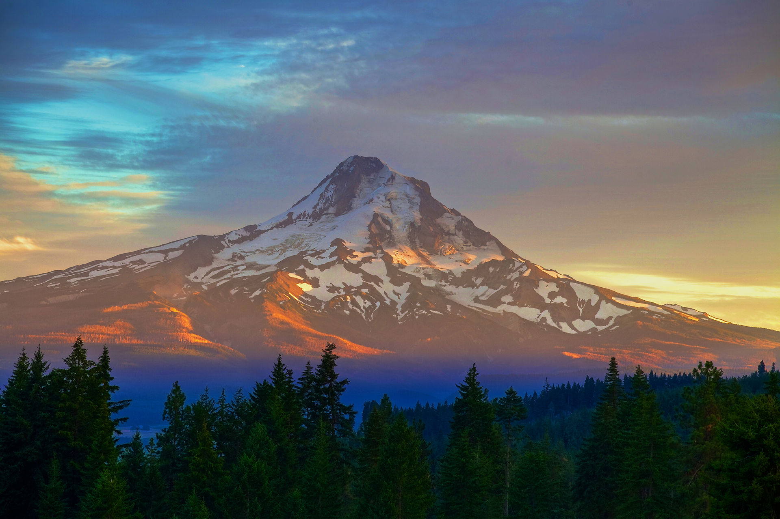
Welcome!
Bibles and copies of sermons are available
Please silence your cell phones
Sunday
Bible Classes 9:30 AM
Worship 10:30 AM
5:30 PM
Wednesday
Bible Classes 7:00 PM
www.SunsetChurchofChrist.net

Slide 2
Ephesians 2:14-18
The great peace of men
- Broken at the Tower of Babel
- The enmity of Jew and Gentile
- Reconciled in the body of Christ
- Access by the Spirit of God

Slide 3
Ephesians 2:19-22
The condition of the saved
1. Relationship with other Saints
2. The concept of the church
- The foundations
3. Your place in the church

Slide 4
Welcome!
Bibles and copies of sermons are available
Please silence your cell phones
Sunday
Bible Classes 9:30 AM
Worship 10:30 AM
5:30 PM
Wednesday
Bible Classes 7:00 PM
www.SunsetchurchofChrist.net

Slide 5
Psalm 2:11
Worship the LORD with reverence
And rejoice with trembling.
Hymns |  |  |  |  |  | Invitation
Red Songbook | - | - | - | - | - | -
Supplemental | - | - | - | - | - | -

Slide 6
Missing Assembly
Notes:
As Jesus moved towards the end of His work, He made a number of “hard” sayings that caused some to walk away. These “hard” sayings still cause some to turn away from God

Slide 7
Expectations of Membership
And let us consider one another in order to stir up love and good works, not forsaking the assembling of ourselves together, as is the manner of some, but exhorting one another, and so much the more as you see the Day approaching. Hebrews 10:24-25

Slide 8
Expectations of Membership
1) The assembly of the saints
- Centered on communion (1 Cor. 11:18-20)
- Sinful to “forsake”
Notes:
1Co 11:18 For first of all, when you come together as a church, I hear that there are divisions among you, and in part I believe it. 19 For there must also be factions among you, that those who are approved may be recognized among you. 20 Therefore when you come together in one place, it is not to eat the Lord's Supper.

Slide 9
Expectations of Membership
1) The assembly of the saints
2) Participation in edification
- Studying the word of God
- Bringing encouragement (1 Thes. 5:11)
- Sinful to ignore
Notes:
1Th 5:11 ¶ Therefore comfort each other and edify one another, just as you also are doing.
1Co 14:26 ¶ How is it then, brethren? Whenever you come together, each of you has a psalm, has a teaching, has a tongue, has a revelation, has an interpretation. Let all things be done for edification.

Slide 10
Expectations of Membership
1) The assembly of the saints
2) Participation in edification
3) Personal engagement
- House to house (Acts 2:46)
- Sinful to ignore (1 John 3:10)
Notes:
Ac 2:46 So continuing daily with one accord in the temple, and breaking bread from house to house, they ate their food with gladness and simplicity of heart,
1Jo 3:10 In this the children of God and the children of the devil are manifest: Whoever does not practice righteousness is not of God, nor is he who does not love his brother.

Slide 11
Expectations of Membership
1) The assembly of the saints
2) Participation in edification
3) Personal engagement
Is missing an assembly “forsaking” it?
Is there a time when I am
permitted to miss the assembly?
Notes:
Ac 2:46 So continuing daily with one accord in the temple, and breaking bread from house to house, they ate their food with gladness and simplicity of heart,
1Jo 3:10 In this the children of God and the children of the devil are manifest: Whoever does not practice righteousness is not of God, nor is he who does not love his brother.

Slide 12
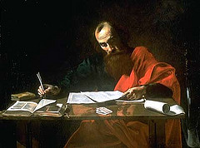
Missing the Assembly
Luke 14:5
Acts 27:33
Missing because of circumstances
Missing because of work
Missing because of sickness (giving, hurting)
…..Is not forsaking the assembly
Notes:
Ac 27:33 And as day was about to dawn, Paul implored them all to take food, saying, "Today is the fourteenth day you have waited and continued without food, and eaten nothing.
Lu 14:5 Then He answered them, saying, "Which of you, having a donkey or an ox that has fallen into a pit, will not immediately pull him out on the Sabbath day?"

Slide 13
Forsaking the Assembly
“My God, My God, why have you forsaken me?”
Forsake: to be absent in that moment by choice
We can forsake the assembly missing it once
“Seek first the kingdom of God”
If we choose to be elsewhere, is it first?
Notes:
This thinking also indicates a double-standard. If a Christian misses one Sunday and says they will be back the next Sunday, they are clearly expecting that the church will be gathered then. This person expects the brethren to be gathered, but the brethren cannot expect the same in return. That is not right, and we all know it.
If a man forsakes his wife only one time, is he guilty of forsaking her?
Jesus’ disciples forsook him only one night

Slide 14
The Fine Line
Am I missing the assembly for fear?
- Chance of a car crash
- Chance of violence
- Chance of getting sick
Don’t let the world tell you how to be faithful
Notes:
- Chance of dying in a car crash (1 in 103)
- Chance of being shot (1 in 285)
- Chance of dying of the flu, coronavirus, etc (1 in 1000)

Slide 15
The Fine Line
Am I missing the assembly for fear?
Am I missing the assembly when:
I would not miss work
I would not miss recreation
I would not miss another opportunity

Slide 16
The Fine Line
Am I missing the assembly for fear?
Am I missing the assembly when:
It is a matter of discernment
Notes:
- Chance of dying in a car crash (1 in 103)
- Chance of being shot (1 in 285)
- Chance of dying of the flu, coronavirus, etc (1 in 1000)

Slide 17
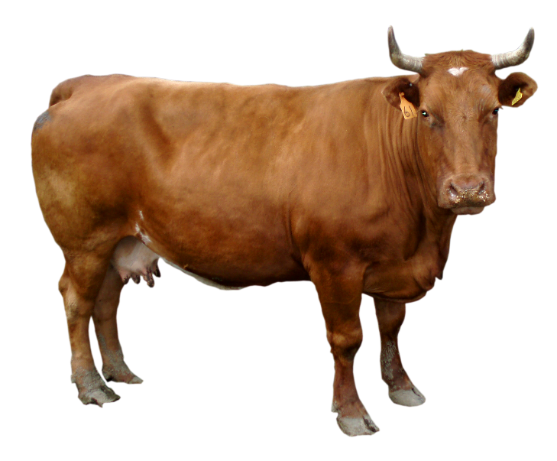
Cows in the Ditch
What if I constantly have reasons not to attend?
If your cow keeps falling in the ditch:
- Put up a fence
- Fill in the ditch
- Ditch the cow
The consequences are not worth it

Slide 18
Cows in the Ditch
What if I constantly have reasons not to attend?
Every legitimate absence hurts:
You
Your brethren

Slide 19
Making Good Choices
All of us will need to miss the assembly at times
Sometimes we don’t really need to miss it
We need to esteem our time with God
We need to esteem our time with each other
Notes:
1Co 11:18 For first of all, when you come together as a church, I hear that there are divisions among you, and in part I believe it. 19 For there must also be factions among you, that those who are approved may be recognized among you. 20 Therefore when you come together in one place, it is not to eat the Lord's Supper.

Slide 21
The Question of Salvation
Being saved means:
Hearing and Believing – Romans 10:17
Confessing Jesus as Lord – Romans 10:9
Repentance from sin – Romans 2:4
Baptism in water into Christ – Romans 6:3
Continuing in Christ – Romans 11:22

